Slide 1
Enhancing Paper Reports
Using the Layout Model
Notes:
Schedule: Timing Topic
<xx> minutes Lecture
<xx> minutes Practice
<xx> minutes Total

Slide 2
Objectives
After completing this lesson, you should be able to do the following:
  Identify the paper report sections
  Design multipanel reports
  Distribute a report to various destinations
  Describe the layout objects and relationships
  Modify an existing paper report layout
  Create variable length lines
Notes:
Lesson Aim
<Enter lesson aim here.>

Slide 3

Viewing the Sections
Header
section
Compensation
Report

Slide 4
Viewing the Sections
Header
section
Compensation
Report
Page 1 of 1
Main
section

Slide 5
Viewing the Sections
Header
section
Compensation
Report
Page 1 of 1
Main
section
Trailer
section
End of report

Slide 6
Viewing the Section Areas
Header
section
Compensation
Report
Body/ Margin
Page 1 of 1
Main
section
Body/ Margin
Trailer
section
End of report
Body/ Margin

Slide 7
Designing Multipanel Reports
Logical Page 1
Panel 1
Physical Page 1
Header
Logical Page 1
Panel 2
Physical Page 2
Logical Page 1
Panel 1
Physical Page 3
Logical Page 1
Panel 2
Physical Page 4
Main
Logical Page 1
Panel 3
Physical Page 5
Logical Page 1
Panel 4
Physical Page 6
Trailer
Logical Page 1
Panel 1
Physical Page 7

Slide 8
Printing Multipanel Reports
Page 1-1
Page 1-2
Page 2-1
Page 2-2
Logical horizontal panels = 2

Slide 9
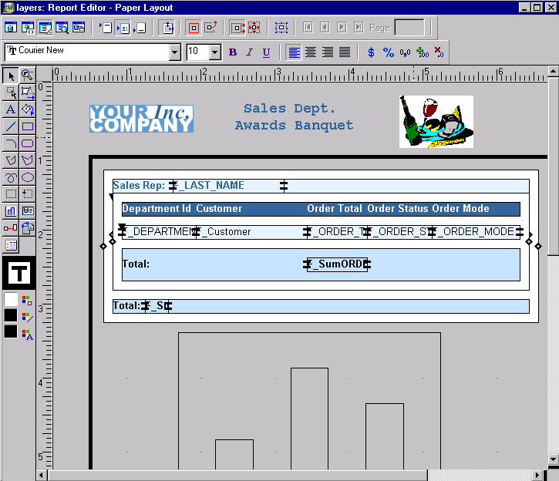
Different Objects in the Paper Layout
4
5
1
2
3
6

Slide 10
Layers of a Tabular Report
F_xxx
F_xxx
R_G_xxx
M_G_xxx
Body

Slide 11
Avoiding Layout Errors
  Confine Mode
  Flex Mode

Slide 12
Report Processing
BEGIN M_G_master…
REPEAT R_G_master
f_xxx
f_xxx
BEGIN M_G_detail
REPEAT R_G_detail
f_xxx
f_xxx
f_xxx
END M_G_detail
END M_G_master

Slide 13

Creating Layout Objects
The tool palette contains:
  Standard GUI drawing tools
  Frame, repeating frame, field objects
  Other layout objects
6
1
2
7
3
8
4
9
5

Slide 14

Layout Tools
  Pin a tool: Double-click
  Shift for constrained objects
  Magnify
  Frame Select
  Report Block

Slide 15
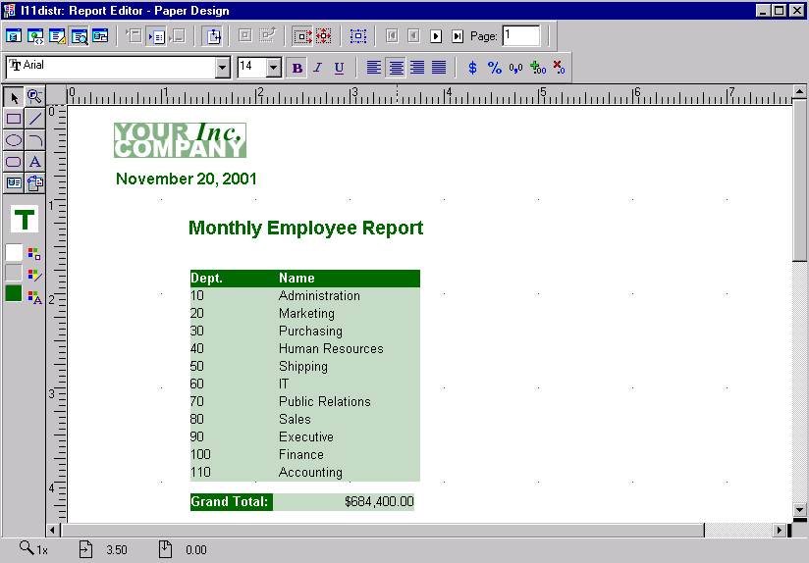
Report Bursting
Header → e-mail

Slide 16
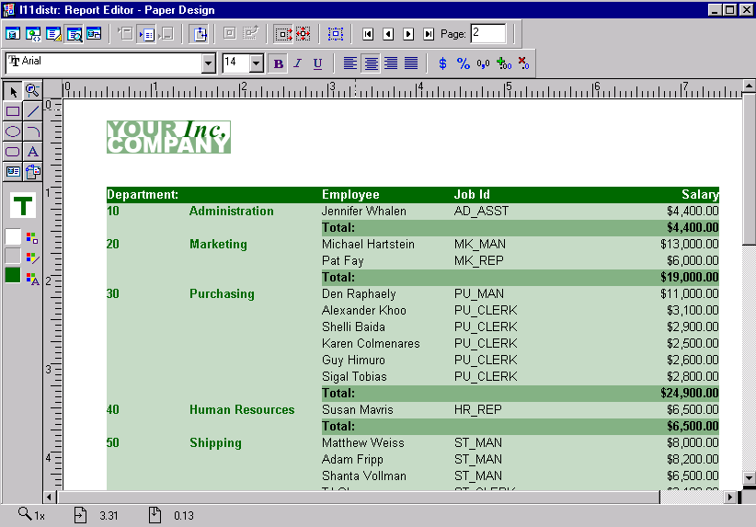
Report Bursting
Header → e-mail
Body → PDF

Slide 17
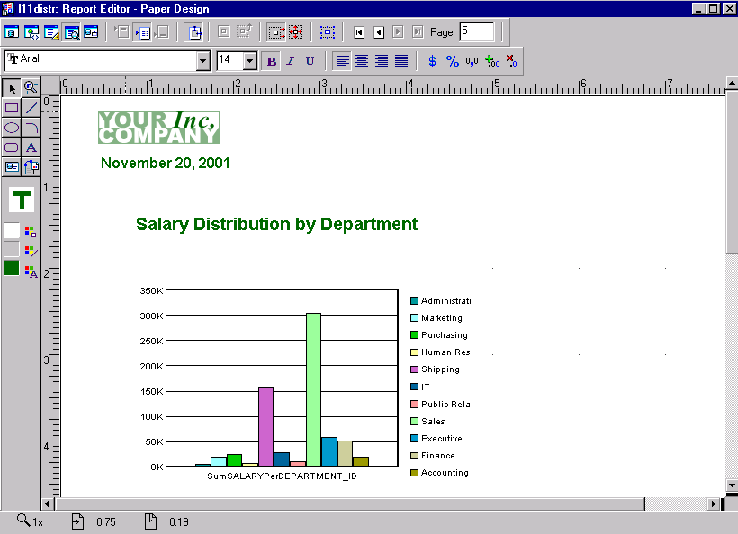
Report Bursting
Header → e-mail
Body → PDF
Trailer → HTML

Slide 18

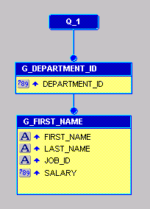
Report Bursting
;
Dept 10
West
East
Dept 20
West
East
Dept 30
West
East
Dept 40
…
…
Dept 80

Slide 19
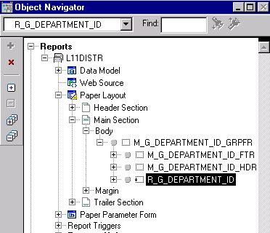
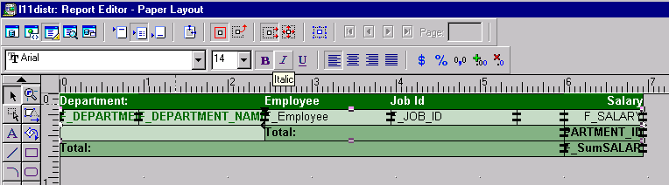
Bursting on a Repeating Group

Slide 20
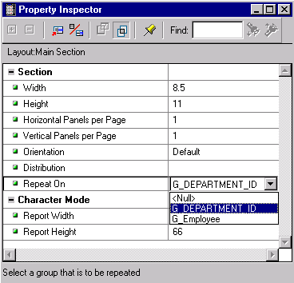
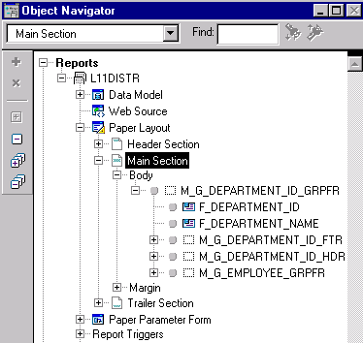
Setting the Repeat On Property

Slide 21
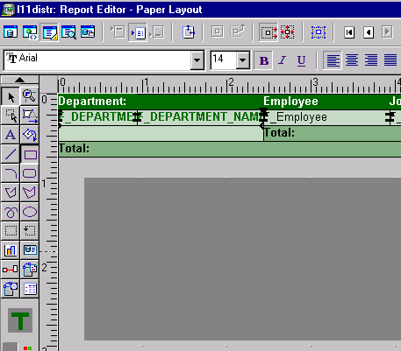
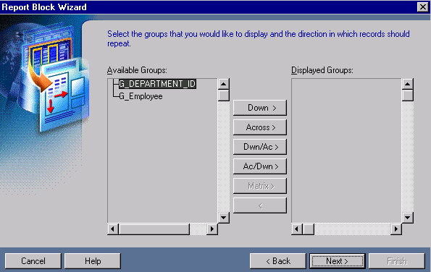
Creating an Additional Layout

Slide 22
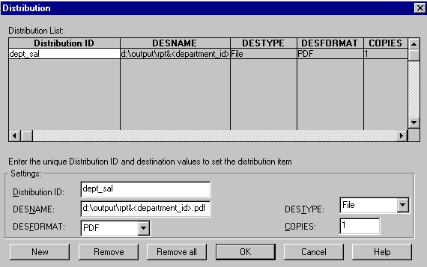
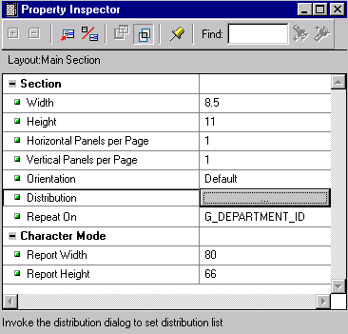
Report Distribution

Slide 23
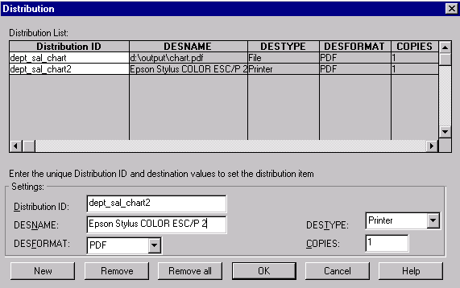
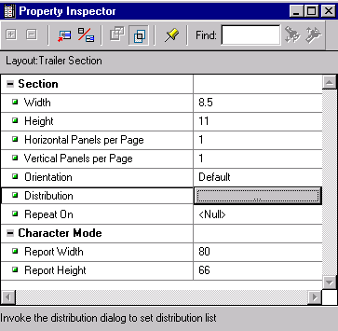
Report Distribution

Slide 24
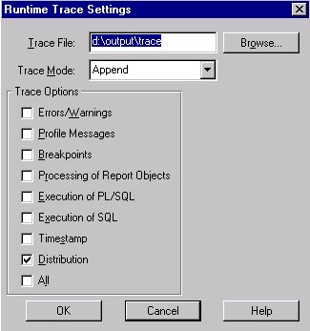
Tracing the Report Distribution

Slide 25
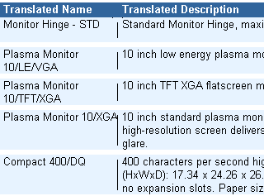

Flex Lines
Flex lines adjust to fit variable frames and repeating frames.

Slide 26
Summary
In this lesson, you should have learned how to modify the Paper Layout using:
  Report sections
  Layout objects and tools
  Report bursting and distribution features
  Variable length lines

Slide 27
Practice 11 Overview
  Using report sections
  Adding a repeating frame to the header page
  Adding flexible lines
  Distributing a report

